Slide 1

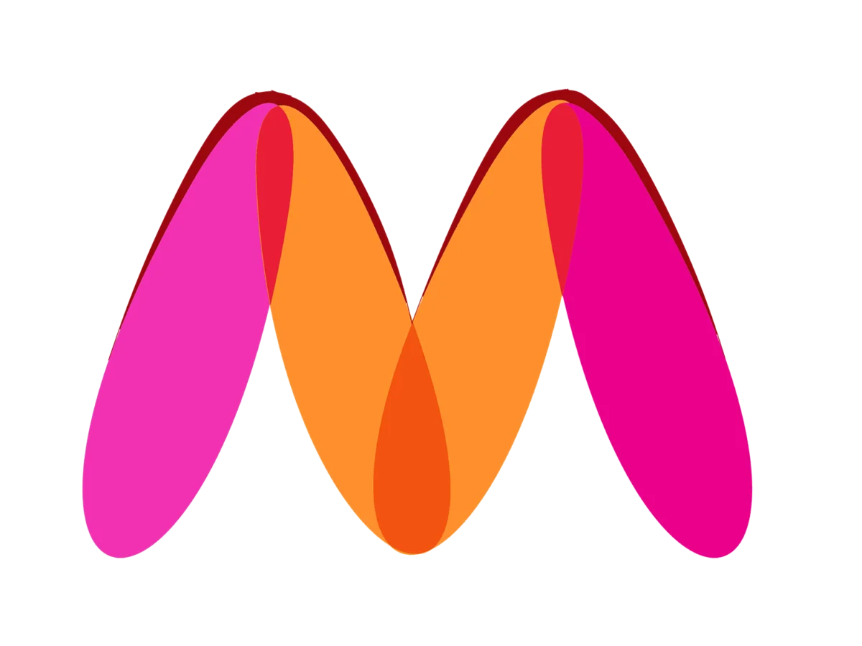
MYNTRA.COM
AD-HOC ANALYSIS FOR PRODUCTS LISTED TILL 04-MAY 2023

Slide 2

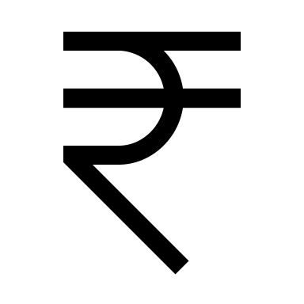
Average price of products listed
The average price of products listed is calculated to be ₹1,538.02

Slide 3
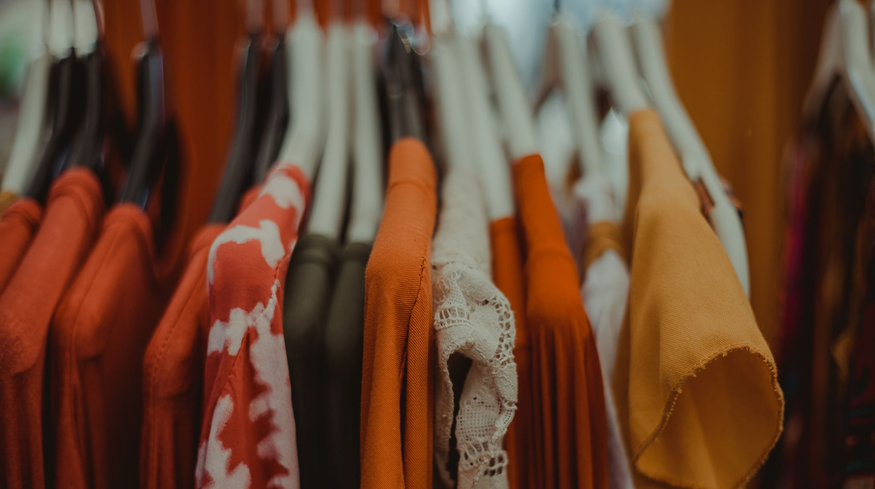
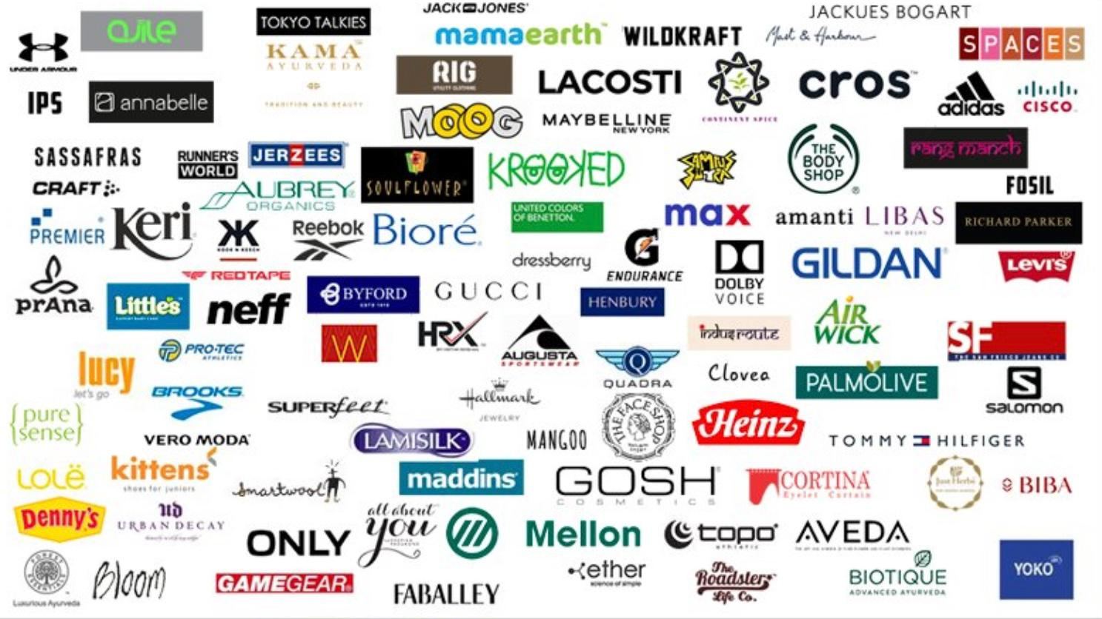
Sellers on MYNTRA
Myntra has distinct range of sellers,with total count of 5,482 distinct sellers

Slide 4

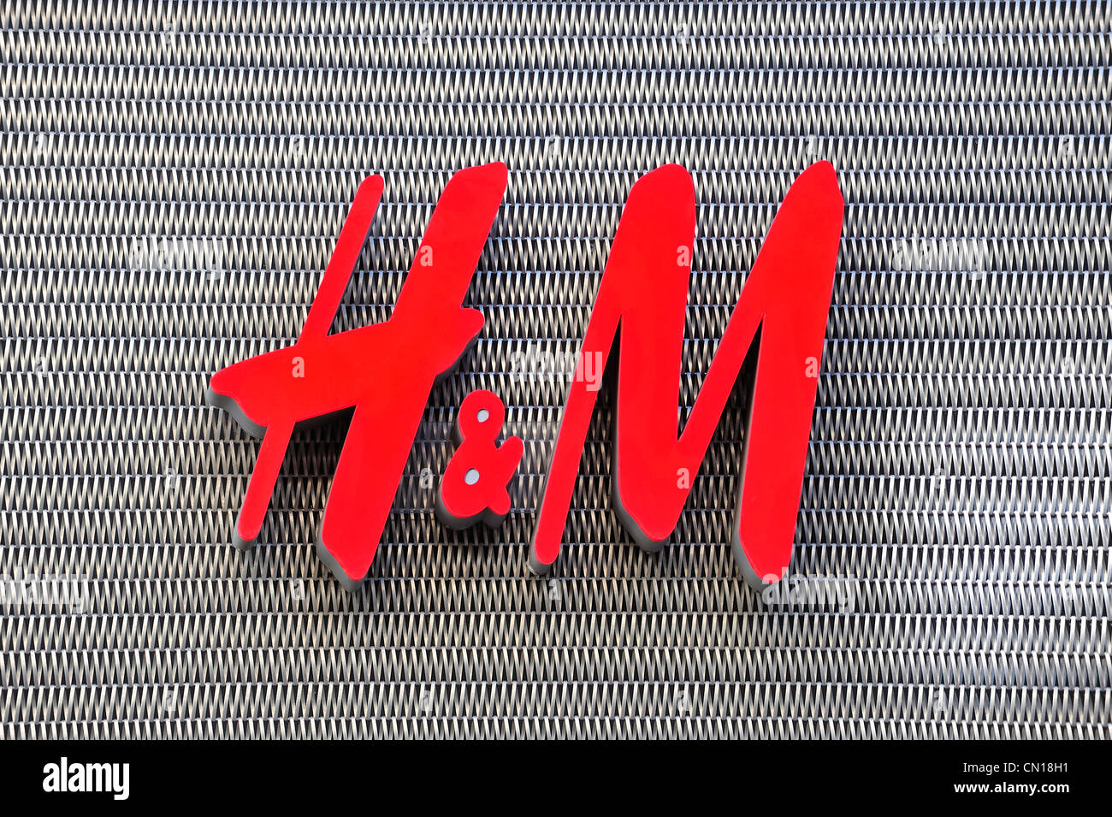


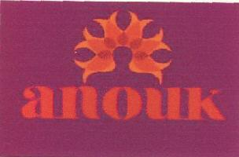
TOP 5 SELLERS (No. Of Products)
Roadster, Number of Products: 10,594
Anouk, Number of Products: 6,078
Max, Number of Products: 6,457
Puma, Number of Products: 6,525
H&M, Number of Products: 6,649

Slide 5

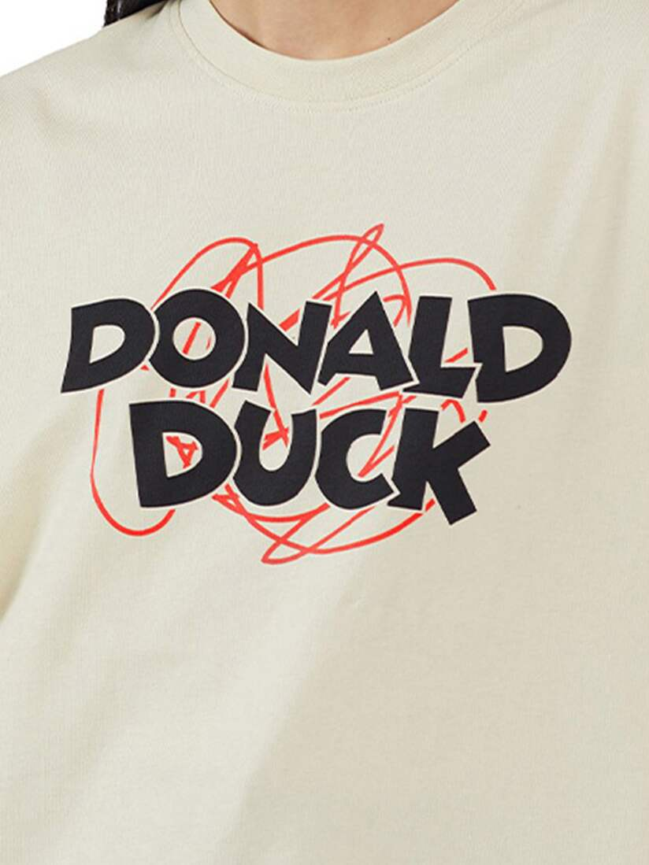
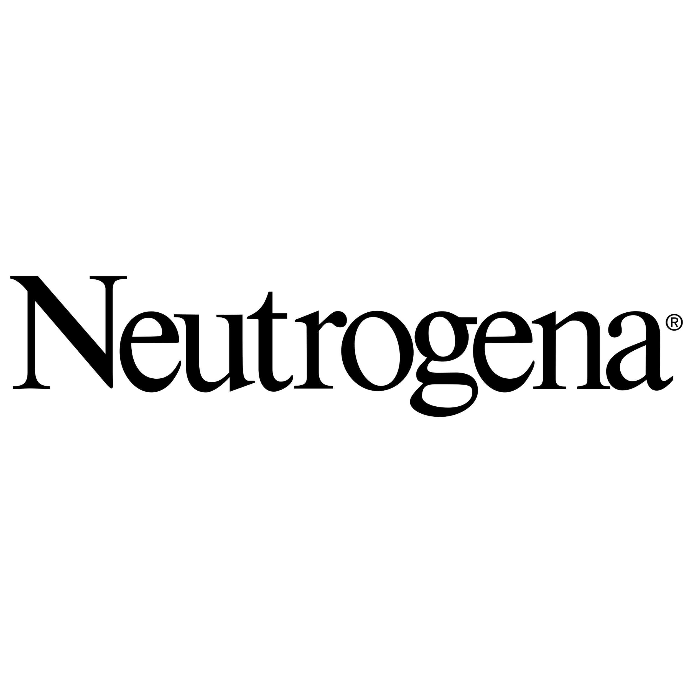

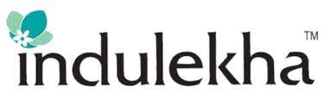
TOP 5 SELLERS (No. Of Reviews and Ratings)
Biotique, Average Rating: 4.00, Number of Reviews: 13,240
Donald Duck, Average Rating: 4.00, Number of Reviews: 5,600
Neutrogena, Average Rating: 4.00, Number of Reviews: 5,500
Maybelline, Average Rating: 4.00, Number of Reviews: 5,328
Indulekha, Average Rating: 4.00, Number of Reviews: 3,955

Slide 6

Products Listings For All
Total Men’s Products: 200,007
Total Women’s Products: 145,146
Total Boy’s Products: 41,649
Total Girl’s Products: 16,096

Slide 7
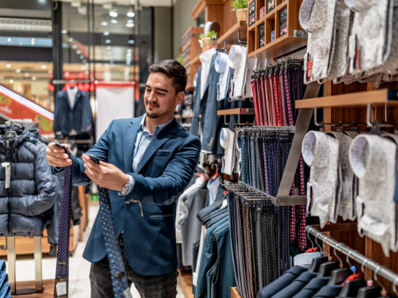
Average prices of products and discount offered
Average Price for Men's Items: ₹1525.10
1
Average Price for Women's Items: ₹1644.76
2
Average Discount for Men's Items: 39%
3
Average Discount for Women's Items: 42%
4

Slide 8

Average rating of products listed
The average rating for all products listed on platform is about 1.60

Slide 9



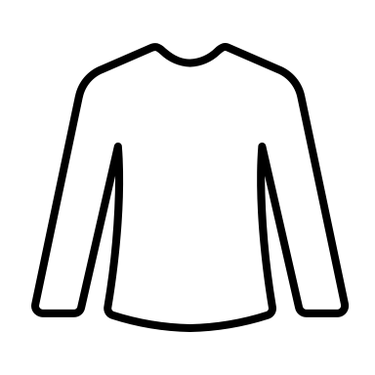
Highest rated categories(Women’s).
The categories with the highest total ratings and average ratings are:
Women Analogue Watch: Total Rating: 268,092, Average Rating: 2.00, Number of Sellers: 122
Pure Cotton T-shirt: Total Rating: 78,242, Average Rating: 3.00, Number of Sellers: 49
Women’s Walking Shoes: Total Rating: 48,555, Average Rating: 2.00, Number of Sellers: 51

Slide 10
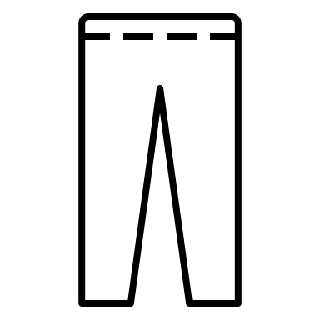
Highest rated categories(Men’s).
The categories with the highest total ratings and average ratings are:
Pure Cotton T-shirt: Total Rating: 468,688, Average Rating: 2.00, Number of Sellers: 217
Slim Fit Jeans: Total Rating: 4,12,097, Average Rating: 2.00, Number of Sellers: 153
Skinny Fit Jeans: Total Rating: 3,25,245, Average Rating: 2.00, Number of Sellers: 92

Slide 11



Average rating
Average Rating for Men’s products: 1.44
Average Rating for Women’s products: 1.24

Slide 12
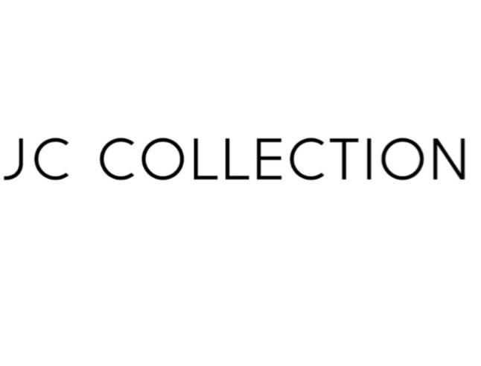

Lowest Rated Brands…
The brands with the most low-rating products in their respective categories are:
Category: 2 Pillow Covers, Seller: JC Collection, Total Products: 747, Low-Rating Products: 741
Category: 2 Pillow Covers, Seller: SWAYAM, Total Products: 566, Low-Rating Products: 436

Slide 13
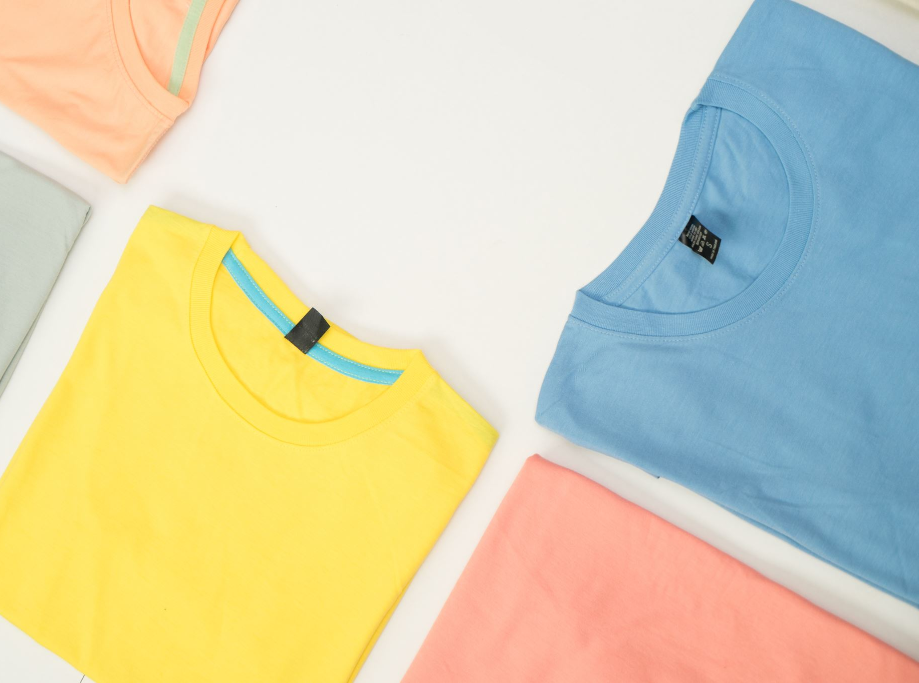
Lowest rated Categories…
The categories with the most products below their average ratings are:
Pure Cotton T-shirt: Total Products: 18,210, Low-Rating Products: 7,605
Polo Collar T-shirt: Total Products: 17,414, Low-Rating Products: 9,013

Slide 14
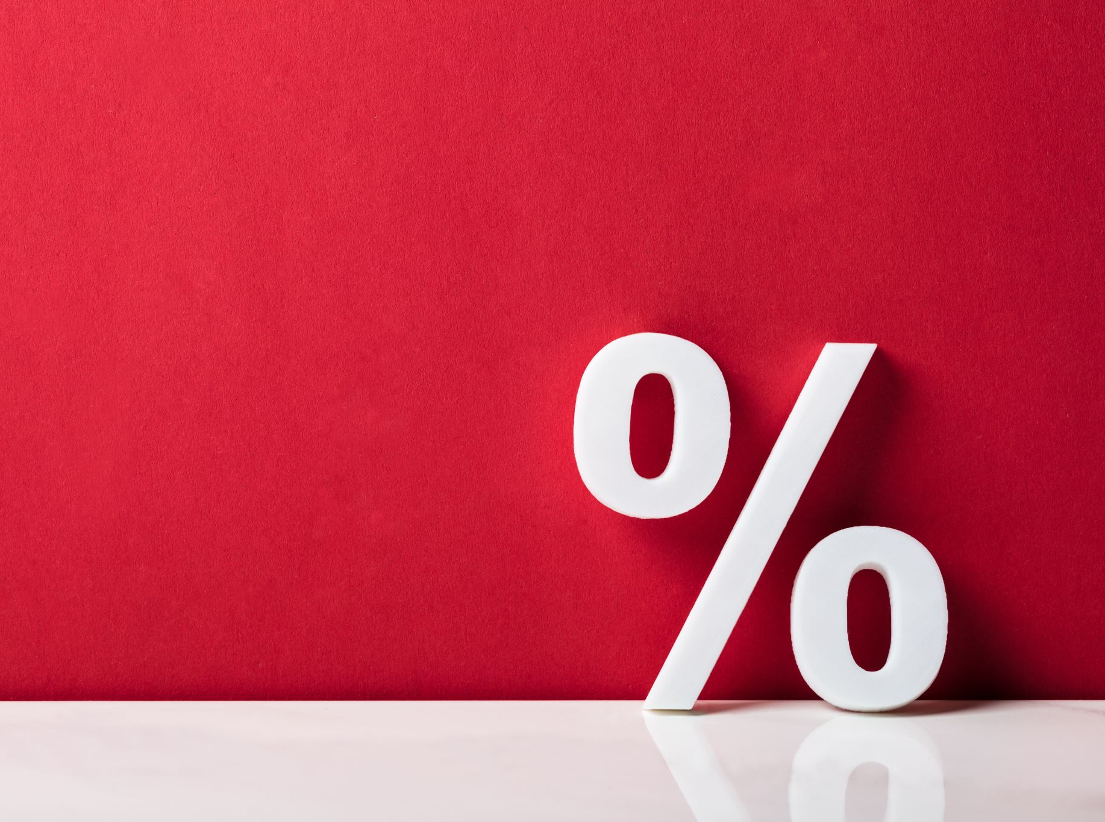
Discount
The brands offering the highest discounts are as follows:
Men's Items Average Discount: 39.12%
Women's Items Average Discount: 42.52%

Slide 15

Highest discounts(Men’s Products)…
The products with the highest discounts Difference(Δ) , compared to the average discount(39.12), are as follows:
Men Penis Enlargement Oil: Δ56.88
Men Printed SPTCAS T-shirt: Δ56.88
Men Mid-Rise Joggers: Δ56.88
Speedy & Easy Men's Hair Color: Δ56.88

Slide 16
Highest discounts(Women’s Products)…
Women's Bikini Briefs:
Various packs with a 96% discount
Average Discount Percentage: 42.52%
Difference from Average: 53.48%

Slide 17
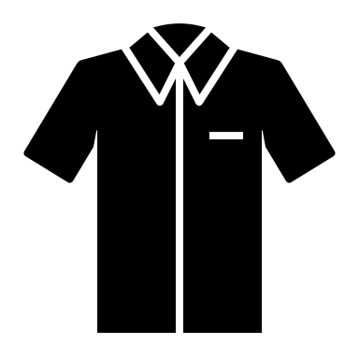
Men’s T-SHIRTS priced higher than average T-shirt price (₹883.7)
Men’s Cotton Polo Collar T-shirt(₹14,800)
Men’s Striped Polo Collar T-shirt(₹10,500)
Men’s Stripped Polo Collar T-shirt(₹9,999.00)
Men’s Polo Collar Loose T-shirt(₹9,150.00)
Men’s Pack Of 2-Solid Thermal T-Shirt (₹9,120.00)

Slide 18
Women’s T-SHIRTS priced higher than average T-shirt price (₹687.3)
Women’s Cotton Polo Collar Slim –Fit T-shirt(₹5,500.00)
Women’s Printed Cotton T-shirt(₹4,999.00)
Women’s Styled back T-shirt(₹4,999.00)
Women’s Cotton T-shirt(₹4,499.00)

Slide 19

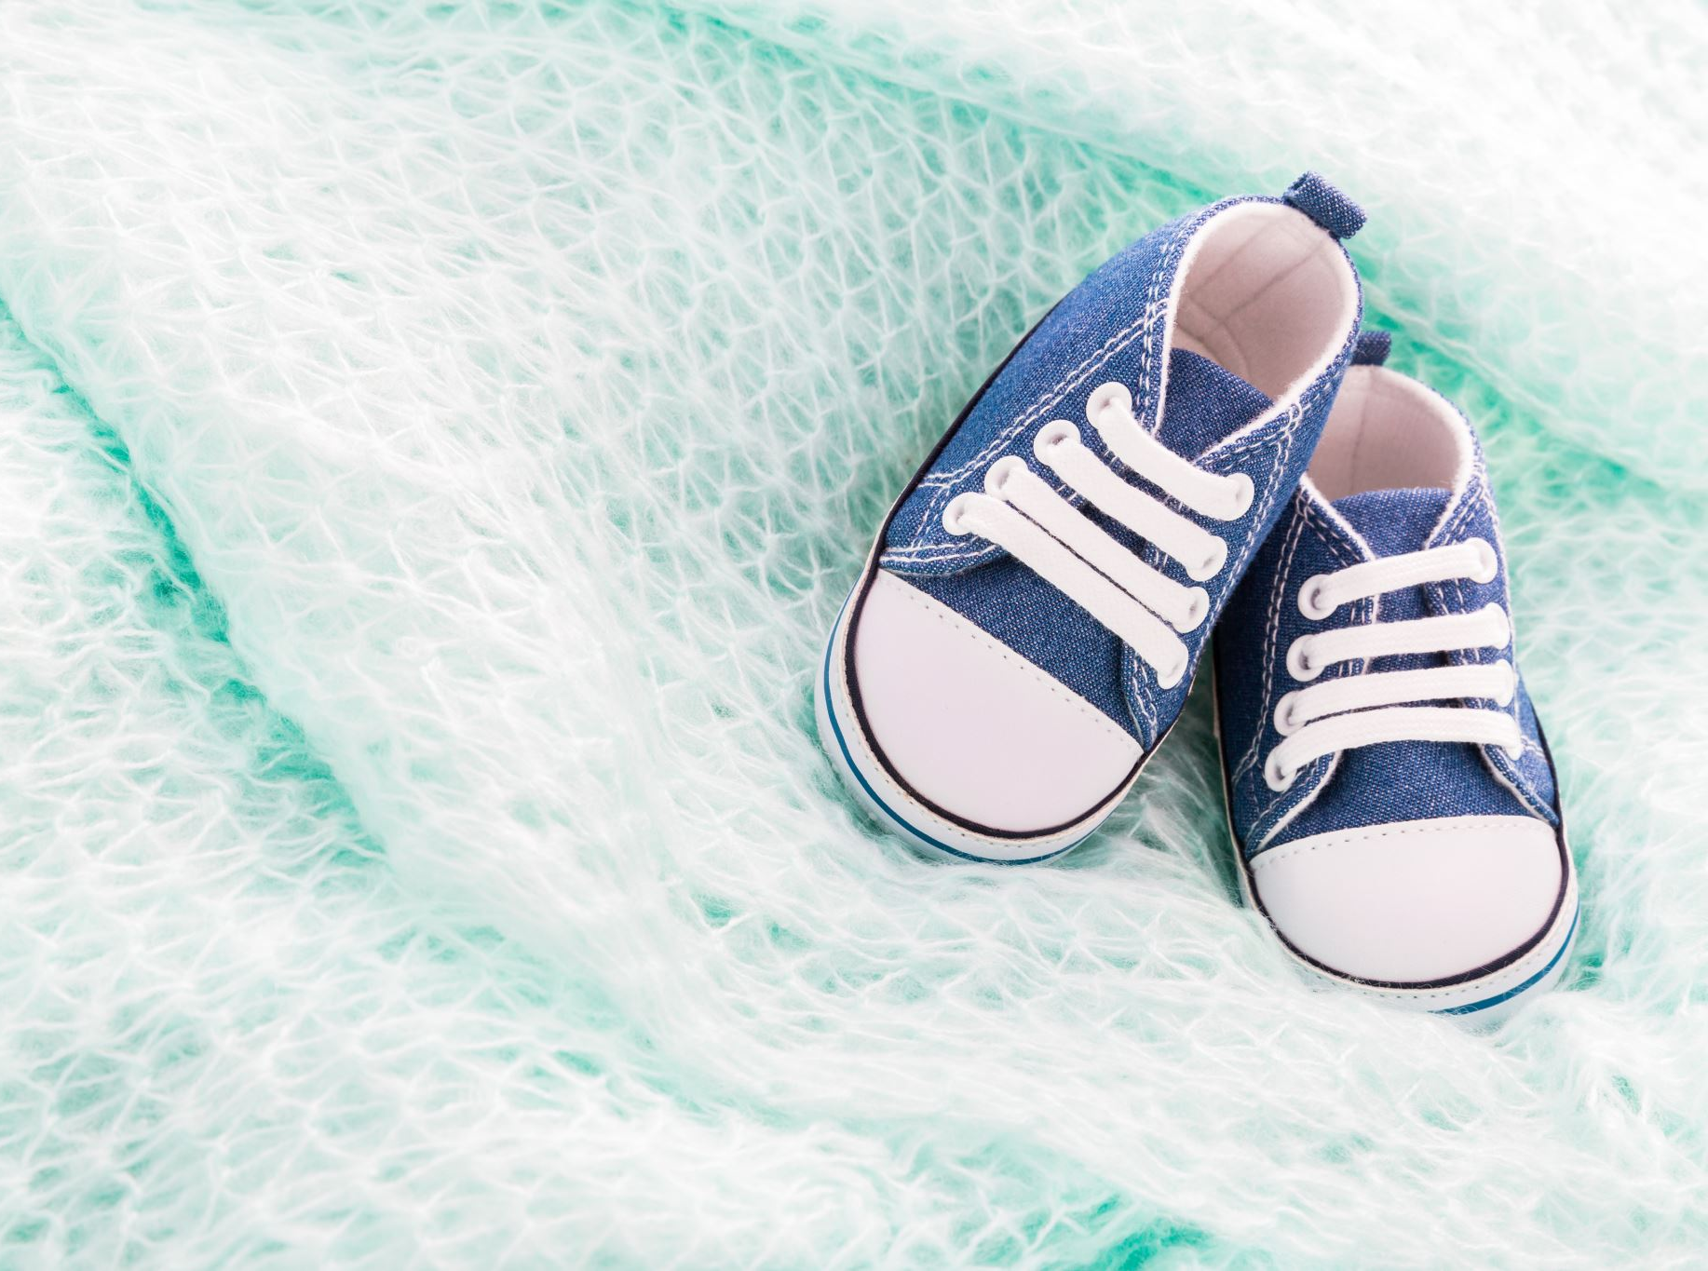
Shoes
Average
Average Discount for Men's Shoes: 36.88%
Average
Average Discount for Women's Shoes: 30.81%
Average
Average Discount for Kids' Shoes: 34.10%

Slide 20
Summary
Market Overview:
Average price of Myntra products: ₹1,538.20.
Presence of 5,482 unique sellers indicates a diverse marketplace.
Seller Performance:
Top sellers like Roadster and H&M dominate product listings, signaling strong market presence.
Despite a high product count, the average rating of 1.60 suggests room for quality improvement.
Consumer Trends:
Higher-priced T-shirt options hint at a demand for premium apparel.
Men's products show higher discounts (92.69%) compared to women's (120.16%), reflecting pricing strategies tailored to gender preferences.

Slide 21
Summary
Brand Insights:
Brands like Biotique and Donald Duck lead in ratings, reflecting a focus on product quality.
Discount Strategies:
Brands offering higher discounts may attract budget-conscious consumers, potentially impacting brand loyalty and profitability.
Category Performance:
Categories like Pure Cotton T-shirts and Slim Fit Jeans exhibit significant discounts compared to category averages, presenting opportunities for strategic pricing adjustments.
Quality Perception:
Products like 2 Pillow Covers show a higher proportion of low ratings, indicating potential quality concerns in specific categories.

Slide 22
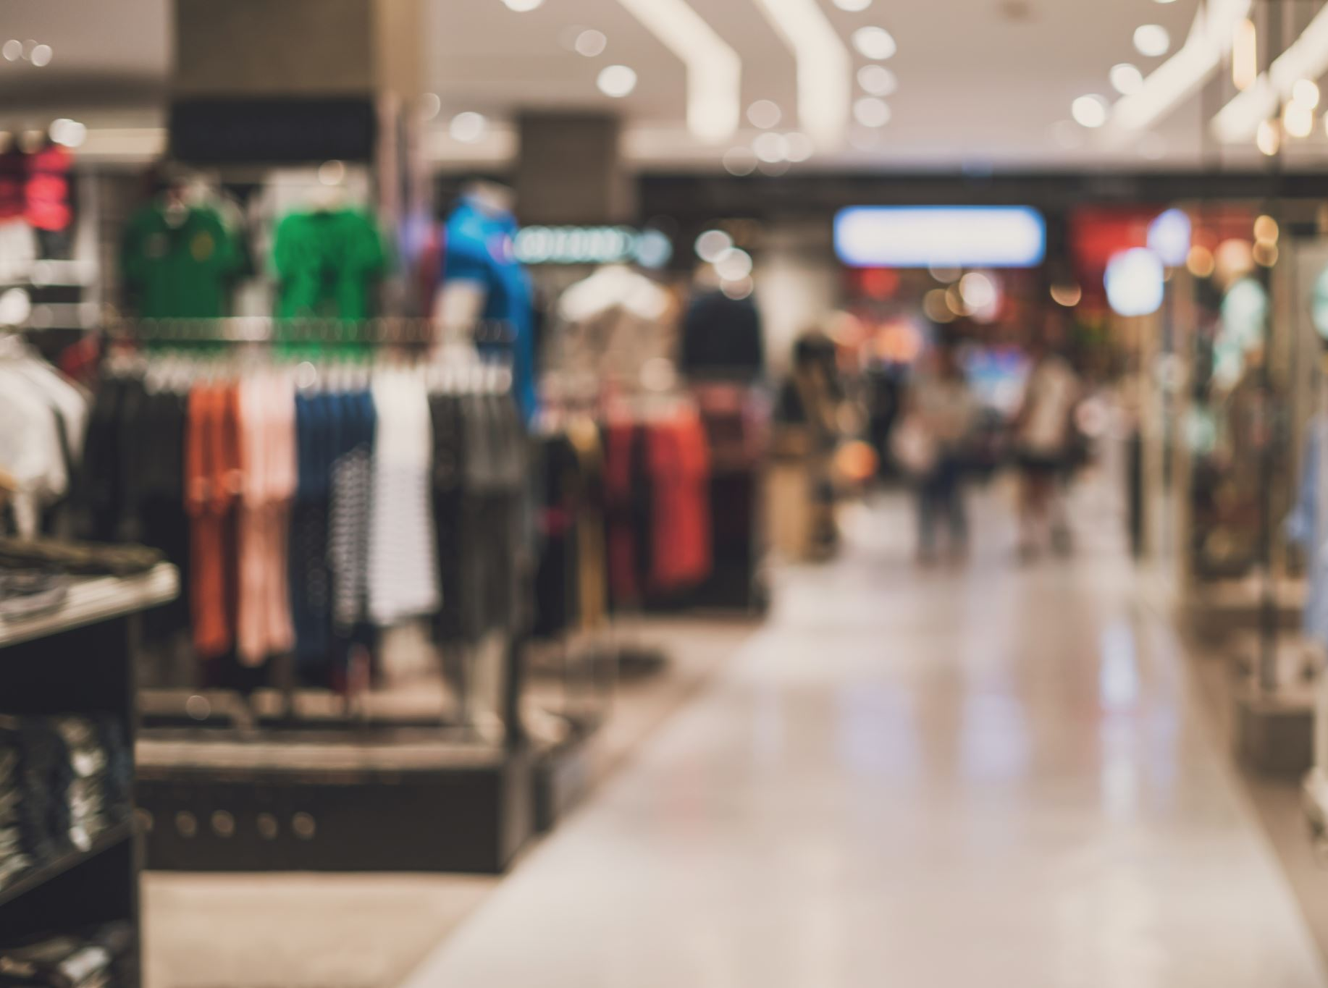
Summary
Gender Preferences:
Men's shoes receive the highest average discount (36.88%), suggesting competitive pricing to capture male consumers.
Market Dynamics:
Despite variations in discount percentages, all shoe categories maintain substantial discounts, reflecting market competitiveness and consumer expectations.
Product Diversity:
Majority of products cater to men, indicating a potential growth area.
Women's products command slightly higher average prices but share similar ratings with men's.

